Slide 1
Fundamentals Of Object-Oriented Programming

Slide 2
Objectives
Describe the different parts of a Java program
Describe a class
Display a class using UML notation
Create classes using Java syntax
Define attributes and methods
Apply object-oriented principles to the design and use of classes

Slide 3
Classes and Objects
Object
  Objects may represent a physical thing
  Objects may represent a conceptual thing
  Contain attributes
  Contain methods
Example:
A cat, a computer, a button on a form.
Classroom J109, G143, etc.
Course CMPP269, CPRG251, etc.

Slide 4
Classes and Objects
Objects have attributes (both constant and variable). A cat has fur, the computer has a keyboard, and the button has a caption. Instructor has a name.
Attributes can change the state of an object and the same property can apply to completely different objects.

Slide 5
Classes and Objects
Attributes
  Describe characteristics of the real world object
  Each real world object will have different values or states for each of the characteristics
Example:
  Object attributes may be age, location, speed, gender, balance, birth date, etc.

Slide 6
Classes and Objects
Methods
  Describe what an object can do
    Cats purr, computers crash, button cancel.
  Execute statements such as calculations, program input and output, change state of attributes or manipulate information etc.

Slide 7
Classes and Objects
Class
  Use classes to put attributes and methods together
  Pattern or model used for the creation of an object
  Defines the attributes or data fields
  Defines the methods or operations
  Tip:
  Think of objects and attributes as nouns, and methods as verbs. The former are things, and the latter are actions that those things can do, or have done to them.

Slide 8
Class Definition
A class is made up of three parts:
    A header declaration or class title
    The data field declarations of the class
    The method definitions of the class
A class is a user defined data type
  Contains details on how this data type will behave and what it will do in your program
Notes:
Look at the example of temperature conversion.

Slide 9
Implement Classes using Java Syntax
A Java source code file contains one or more Java classes.
The public class and the filename of the source code file must match.
    ex: A class named Simple must be in a file named Simple.java
Each Java class can be separated into parts.
Example: Simple.java

Slide 10
Implement Classes using Java Syntax
To compile the example:
  javac Simple.java
    Notice the .java file extension is needed.
    This will result in a file named Simple.class being created.
To run the example:
  java Simple
    Notice there is no file extension here.
    The java command assumes the extension is .class.

Slide 11
Implement Classes using Java Syntax
Comments
  The line is ignored by the compiler.
  The comment in the example is a single-line comment.
Class Header
  The class header tells the compiler things about the class such as what other classes can use it (public) and that it is a Java class (class), and the name of that class (Simple).
Curly Braces
  When associated with the class header, they define the scope of the class.
  When associated with a method, they define the scope of the method.

Slide 12
Implement Classes using Java Syntax
Header Declaration
  identifies the name of the class
  declares the visibility of the class
  declares what class (if any) the object extends
  e.g. public class Temperature
Notes:
The reserve words public, private, protected or static indicates visibility of the the user defined data type to the rest of the program. In the class Fahrenheit the visibility is declared as Public so it can be referenced (used) by other classes.

Slide 13
Implement Classes using Java Syntax
Data Field Declarations
  Used to declare identifiers (attributes)
  Identifiers can be private, public or protected
  Data fields should be initialized
  e.g. private double temp;

Slide 14
Implement Classes using Java Syntax
Data Types
  Primitive type int
    positive or negative whole numbers
    operations include add, subtract, multiply, divide, remainder
    e.g. -32 15435
Type | Storage (Bytes) | Range
int | 4 | -2.15x10⁹ to 2.15x10⁹
byte | 1 | -128 to 127
short | 2 | -32,678 to 32,767
long | 8 | -9.2x10¹⁸ to 9.2x10¹⁸

Slide 15
Implement Classes using Java Syntax
Data Types
  Primitive type double
    positive or negative real numbers (numbers with decimal places
    operations include add, subtract, multiply, divide
    e.g. 3.14159 2.137e4
Type | Storage (Bytes) | Range
float | 4 | -1.4x10⁻⁴⁵ to 3.4x10⁺³⁸
double | 8 | -4.9x10⁻³²⁴ to 1.8x10⁺³⁰⁸

Slide 16
Implement Classes using Java Syntax
Data Types
  Primitive type boolean
    true or false (i.e. 1 or 0)
    requires 1 byte of memory storage
    operations include decision and repetition logic

Slide 17
Implement Classes using Java Syntax
Data Types
  Primitive type char
    individual characters
    requires 2 bytes of memory storage
    operations include comparisons
    e.g. ‘A’ ‘7’ ‘?’ ‘a’

Slide 18
Implement Classes using Java Syntax
Data Types
  String Class
    NOTE: string is NOT a primitive data type
    It is a CLASS that stores a sequence of characters
    Operations include methods to compare, concatenate, and take apart strings of characters
    e.g. “Abcd” “A” “Enter a Number”

Slide 19
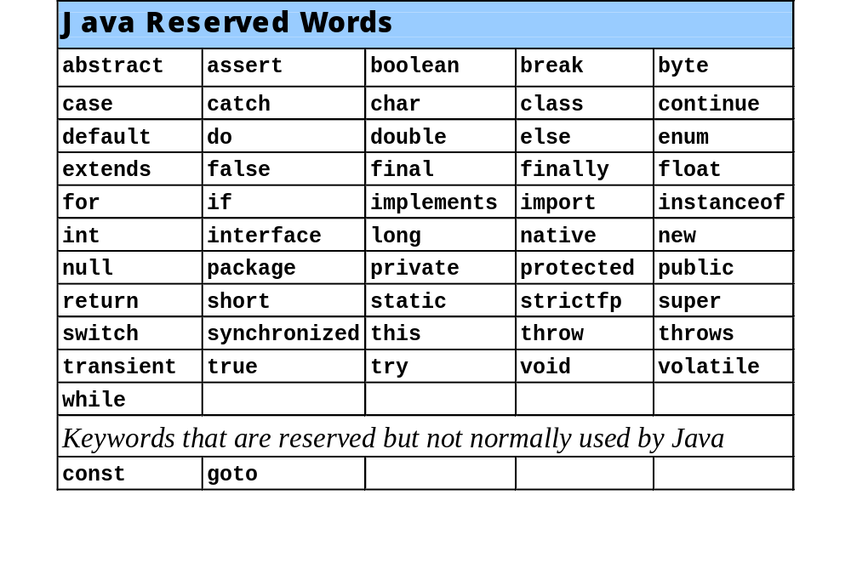

Slide 20
Access Modifiers
An access modifier is a Java keyword that indicates how a field or method can be accessed.
There are three Java access modifiers:
  public
  private
  protected

Slide 21
Access Modifiers
public: This access modifier states that any other class can access the resource.
private: This access modifier indicates that only data within this class can access the resource.
protected: This modifier indicates that only classes in the current package or a class lower in the class hierarchy can access this resource.
These will be explained in greater detail later.

Slide 22
The Class Declaration
The class is the fundamental unit of programming in Java.
Example:
keyword
public class Point
{
.
.
.
}
visibility
user-specified class name (capitalized)
delimiters
class contents
(code to be filled in later)

Slide 23
Attributes and Methods
attributes and methods are defined inside the class declaration.
Instance variables or Class level attributes are associated with each instance of the class.
  There may be many copies of these variables, one copy for each instance of the class.
Instance methods operate on a particular instance of a class (i.e. on an object).

Slide 24
Attributes and Methods
Example:
public class Point
{
private double x, y;
public void setx(double value)
{
x = value;
}
public double gety()
{
return y;
}
}
instance variables
method return data type
method name
parameter
instance methods
sets the x instance variable to a new value
parameter data type
returns the value of y to the calling function

Slide 25
Classes
A reference variable contains the address of an object.
  Point pointOne = new Point(3.3,4.4)
The object that contains the
character string “Charleston”
x = 3.3
y = 4.4
pointOne
Address to the object

Slide 26
Classes and Instances
Many objects can be created from a class.
Each object is independent of the others.
  Point pointOne = new Point(3.3,4.4);
  Point pointTwo = new Point(5.5,7.7);
  Point pointThree = new Point(6.6,8.8);

Slide 27
Classes and Instances
x = 3.3
y = 4.4
pointOne
Address
x = 5.5
y = 7.7
pointTwo
Address
x = 6.6
y = 8.8
pointThree
Address

Slide 28
Classes and Instances
Each instance of the class Point contains different data.
The instances all share the same design.
Each instance has all of the attributes and methods that were defined in the Point class.
Classes are defined to represent a single concept or service.

Slide 29
Encapsulation
Classes should be as limited in scope as needed to accomplish the goal.
Each class should contain all that is needed for it to operate.
Enclosing the proper attributes and methods inside a single class is called encapsulation.
Encapsulation ensures that the class is self-contained.

Slide 30
Designing a Class
When designing a class, decisions about the following must be made.
  what data must be accounted for (attributes),
  what actions need to be performed (methods),
  what data can be modified,
  what data needs to be accessible, and
  any rules as to how data should be modified.
Class design typically is done with the aid of a Unified Modeling Language (UML) diagram.

Slide 31
UML Class Diagram
A UML class diagram is a graphical tool that can aid in the design of a class.
The diagram has three main sections.
ClassName
UML diagrams are easily converted
to Java class files. There will be more
about UML diagrams a little later.
Attributes
Methods
The class name should concisely reflect what
the class represents.

Slide 32
Attributes
The data elements of a class defines the object to be instantiated from the class.
The attributes must be specific to the class and define it completely.
Example: A rectangle is defined by
  length
  width.
The attributes are then accessed by methods within the class.

Slide 33
Data Hiding
Another aspect of encapsulation is the concept of data hiding.
Classes should not only be self-contained but they should be self-governing as well.
Classes use the private access modifier on fields to hide them from other classes.
Classes need methods to allow access and modification of the class’ data.

Slide 34
Accessors and Mutators
(Getters and Setters)
Because of the concept of data hiding, fields in a class are private.
The methods that retrieve the data of fields are called accessors (getters).
The methods that modify the data of fields are called mutators (setters).
Each field that the programmer wishes to be viewed by other classes needs an accessor.
Each field that the programmer wishes to be modified by other classes needs a mutator.

Slide 35
Stale Data
Some data is the result of a calculation.
Consider the area of a rectangle.
  length x width
It would be impractical to use an area variable here.
Data that requires the calculation of various factors has the potential to become stale.
To avoid stale data, it is best to calculate the value of that data within a method rather than store it in a variable.

Slide 36
Stale Data
Rather than use an area variable in a rectangle class:
  public double getArea()
  {
  return length * width;
  }
This dynamically calculates the value of the rectangle’s area when the method is called.
Now, any change to the length or width variables will not leave the area of the rectangle stale.

Slide 37
UML Data Type and Parameter Notation
UML diagrams are language independent.
UML diagrams use an independent notation to show return types, access modifiers, etc.
Rectangle
Access modifiers are denoted as:
  + public
  - private
  # protected
- width : double
+ setWidth(w : double) : void

Slide 38
UML Data Type and Parameter Notation
UML diagrams are language independent.
UML diagrams use an independent notation to show return types, access modifiers, etc.
Variable types are placed after the variable name, separated by a colon.
Rectangle
- width : double
+ setWidth(w : double) : void

Slide 39
UML Data Type and Parameter Notation
UML diagrams are language independent.
UML diagrams use an independent notation to show return types, access modifiers, etc.
Rectangle
Method return types are placed after the method declaration name, separated by a colon.
- width : double
+ setWidth(w : double) : void

Slide 40
UML Data Type and Parameter Notation
UML diagrams are language independent.
UML diagrams use an independent notation to show return types, access modifiers, etc.
Method parameters are shown inside the parenthesis using the same notation as variables.
Rectangle
- width : double
+ setWidth(w : double) : void

Slide 41
Converting the UML Diagram to Code
Putting all of this information together, a Java class file can be built easily using the UML diagram.
The UML diagram parts match the Java class file structure.
class header
{
Attributes
Methods
}
ClassName
Attributes
Methods

Slide 42
Convert an UML Diagram to Code
public class Rectangle
{
private double width;
private double length;
public Rectangle(){}
public Rectangle(double w, double l)
{
width = w;
length = l;
}
public void setWidth(double w){
width = w;
}
public void setLength(double len){
length = len;
}
public double getWidth(){
return width;
}
public double getLength(){
return length;
}
public double getArea(){
return length * width;
}
}
Once the class structure has been designed, the class body can be written and tested.
Rectangle
width : double
length : double
+Rectangle( )
+Rectangle(w:double,l:double)
+ setWidth(w : double) : void
+ setLength(len : double: void
+ getWidth() : double
+ getLength() : double
+ getArea() : double

Slide 43
Class Layout Conventions
The layout of a source code file can vary by employer or instructor.
Typically the layout is generally:
  Constants
  Attributes
  Constructors
  Methods
    The main method is sometimes first, sometimes last.
    Accessors and mutators are typically grouped.
  Any private support methods
There are tools that can help in formatting layout to specific standards.

Slide 44
A Driver Program
An application in Java is a collection of classes that interact.
The class that starts the application must have a main method.
This class can be used as a driver to test the capabilities of other classes.
In the Rectangle class example, notice that there was no main method.

Slide 45
A Driver Program
public class Rectangle
{
private double width;
private double length;
public Rectangle(){}
public Rectangle(double w, double l)
{
width = w;
length = l;
}
public void setWidth(double w){
width = w;
}
public void setLength(double len){
length = len;
}
public double getWidth(){
return width;
}
public double getLength(){
return length;
}
public double getArea(){
return length * width;
}
}
public class Main
{
public static void main(String [] args)
{
Rectangle r = new Rectangle();
r.setWidth(10);
r.setLength(10);
System.out.println(“Width = ”
+ r.getWidth());
System.out.println(“Length = ”
+ r.getLength());
System.out.println(“Area = ”
+ r.getArea());
}
}

Slide 46
Arguments Passed By Value
In Java, all arguments to a method are passed “by value”.
If the argument is a reference to an object, it is the reference that is passed to the method.
If the argument is a primitive, a copy of the value is passed to the method.

Slide 47
Constructors
Classes can have special methods called constructors.
Constructors are used to perform operations at the time an object is created.
Constructors typically initialize instance fields and perform other object initialization tasks.

Slide 48
Constructors
Constructors have a few special properties that set them apart from normal methods.
  Constructors have the same name as the class.
  Constructors have no return type (not even void).
  Constructors may not return any values.
  Constructors are typically public.

Slide 49
The Default Constructor
If a default constructor is not defined, Java provides an empty one.
  It sets all of the class’ numeric fields to 0.
  It sets all of the class’ boolean fields to false.
  It sets all of the class’ reference variables, the default constructor sets them to the special value null.
The default constructor is a constructor with no parameters.
Default constructors are used to initialize an object in a default configuration.

Slide 50
Constructors in UML
In UML, the most common way constructors are defined is:
Rectangle
Notice there is no
return type listed
for constructors.
width : double
length : double
+Rectangle( )
+Rectangle(len:double, w:double)
+ setWidth(w : double) : void
+ setLength(len : double): void
+ getWidth() : double
+ getLength() : double
+ getArea() : double

Slide 51
The Rectangle Class Constructor
One of the Rectangle class constructors accepts a two double parameters as arguments.
These doubles are used to initialize a Rectangle object.
For instance:
  Rectangle box = new Rectangle(2.88,4.76);

Slide 52
The BankAccount Example
BankAccount
balance : double
interestRate : double
interest : double
+BankAccount(startBalance:double,
intRate :double):
+ deposit(amount : double) : void
+ withdrawl(amount : double: void
+ addInterest() : void
+ getBalance() : double
+ getInterest() : double

Slide 53
Classes, Variables and Scope
The list below shows the scope of a variable depending on where it is declared.
  Inside a method:
    Visible only within that method.
    Called a local variable.
  In a method parameter:
    Called a parameter variable.
    Same as a local variable
    Visible only within that method.
  Inside the class but not in a method:
    Visible to all methods of the class.
    Called an instance field or attribute field.

Slide 54
Shadowing
A parameter variable is, in effect, a local variable.
Within a method, variable names must be unique.
A method may have a local variable with the same name as an instance field.
This is called shadowing.
The local variable will hide the value of the instance field.
Instance variables can be distinguished from local variables by the use of the “this” operator.

Slide 55
Object Oriented Design
Finding Classes and Their Responsibilities
Finding the classes
  Get written description of the problem domain
  Identify all nouns, each is a potential class
  Refine list to include only classes relevant to the problem
Identify the responsibilities
  Things a class is responsible for knowing
  Things a class is responsible for doing
  Refine list to include only classes relevant to the problem

Slide 56
Object Oriented Design Exercise
Finding Classes and Their Responsibilities
Consider the following problem description:
Users place coins in a vending machine and select a product by pushing a button. If the inserted coins are sufficient to cover the purchase price of the product, the product is dispensed and the change is given. Otherwise, the inserted coins are returned to the user.
What classes should you use to implement it?

Slide 57
Object Oriented Design Exercise
Finding Classes and Their Responsibilities
Consider the following problem description:
Employees receive their biweekly paychecks. They are paid their hourly rates for each hour worked; however, if they worked more than 40 hours per week, they are paid overtime at 150% of the regular wage.
What classes should you use to implement it?

